Slide 1
Asthma in Pregnancy
James Huang
Obstetrics Rotation
October 20, 2009

Slide 2
A.B.
16 y/o G1P0000 at 40⁰ by LMP 12/30/08, c/w 1st semester U/S with EDD 10/6/09 who presents with c/o decreased fetal movement. Pt reports 2 fetal kicks/hour, starting the day before. +vomitting, -N/F/C/D/VB/LOF
PNC: Total 9 visits, BPs normal
PNI: 1) Asthma: Flovent 220mcg, albuterol 2x/day or every other day, hospitalized 5 times as an infant, no recent hospitalizations, no intubations or recent steroid use.
2) teen pregnancy: lives in shelter for pregnant women, FOB (19 y/o) involved and supportive, no DV, in 11th grade and plans to return, mother is now supportive

Slide 3
A.B.
PNL: O⁺ ,all other labs WNL
Sono: most recent: Placenta anterior, AFI 13, EFW-2182gm (48%), cervical length-3.3cm
Pobhx: none
Pgynhx: non contributory
PMHx: asthma, as above
PSH: tonsillectomy-2008
Meds: PNV, Fe, Flovent, Albuterol
NKDA
SH: as above, denies T/E/D

Slide 4
A.B.
VS: 99/64 98.4 76 20
PE: WNL
SSE: -pooling/nitrazine/ferning
SVE: L/C/high
EFW: 3200gm
Sono: VTX, AFI-3, BPP 8/10,
FHT: 130s, Mod. Variability +accels, -decels
Toco: none

Slide 5
A.B.
16 y/o G₁P₀₀₀₀ at 40⁰ with c/o decreased FM, now found to have oligohydramnios (AFI-3)
What is the plan?
Admit to L&D, NPO, IVF, routine labs, fetal monitoring
Labor: cervix is unfavorable, pt not contracting, cytotec vs cervidil
SW consult
How does the patient’s asthma effect her pregnancy and intrapartum management?

Slide 6
Outline
Physiology: Pulmonary changes
Asthma
Asthma in pregnancy
Asthma medications
Acute exacerbation
Patient Education
Intrapartum issues
Summary

Slide 7
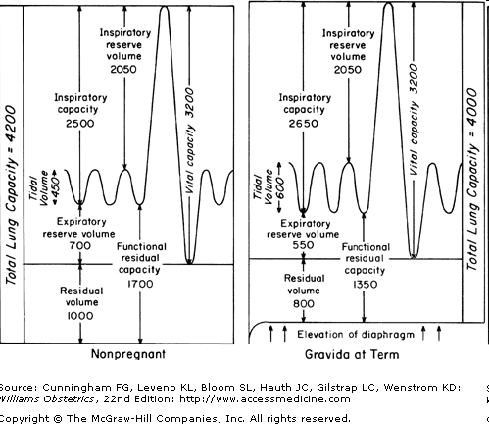
Physiology: Pulmonary changes
TLC decreased by 5%, Tidal volume (V_{T}) increases by 30-40%
V_{T} increase leads to
increase in minute
ventilation of 30-40%
leading to decreased
P_{CO2}
By the 20th week,
P_{CO2} levels drop to
30 mm Hg
Notes:
RR unchanged, secondary to progesterone

Slide 8
Physiology: Pulmonary changes
Decreased P_{CO2} level leads to a respiratory alkalosis
Compensation: bicarb goes down to 22 mmol/L
Thus in a pregnant woman with a normal P_{CO2} level is concerning for impaired ventilation

Slide 9
Physiology: Pulmonary changes
Differential?
Asthma
Physiological dyspnea of pregnancy
PE
Pulmonary edema
Peripartum cardiomyopathy
Amniotic fluid embolism
Notes:
Progesterone

Slide 10
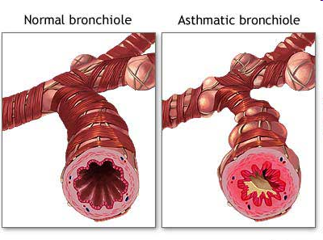
Asthma
Chronic inflammatory pulmonary disorder that is characterized by reversible obstruction of the bronchioles
Notes:
http://www.bio.davidson.edu/COURSES/GENOMICS/2008/Waters/asthma2.jpg

Slide 11
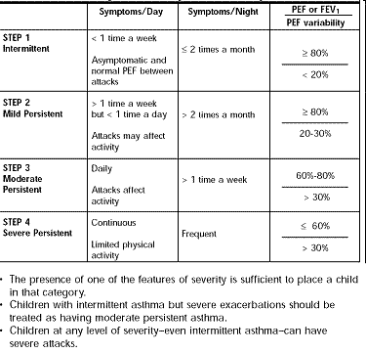
Asthma
Notes:
http://www.med.nus.edu.sg/paed/academic/AP_asthma_today_files/image004.gif

Slide 12
Asthma in pregnancy
4-8% of pregnant women have asthma
Asthma course: 1/3 remain stable, 1/3 worsen, and the other 1/3 improve
Some studies have shown improvement in first few months, followed by relative worsening around 29th week, then late pregnancy improvement
more likely to have an URI or UTI (35%) than pregnant women without asthma (5%)
Notes:
http://www.envirotech-online.com/assets/images/iet/pr_files/pr_3908/images/Pregnant_1845_19027754_0_0_7915_300.jpg

Slide 13
Asthma in pregnancy
Having a boy or girl can influence asthma in pregnancy
Measured asthma severity by comparing predicted and measured peak expiratory flow (PEF), women with male fetuses had 10% improvement in airway lability
Testosterone may potentiate beta-adrenergic relaxation of bronchial tissue and inhibits response to histamine
Sex-specific factors related to female fetus may promote activation of inflammatory pathways
Notes:
Obstervational study in 1998, then this study in 2005
http://outlooked.files.wordpress.com/2008/10/male_female_symbol.jpg

Slide 14
Asthma in pregnancy
Asthma associated complications:
Hyperemesis
Hypertension / pre-eclampsia
Vaginal hemorrhage
Complicated labor
IUGR (369gm-434gm lower)
Preterm birth
Increased perinatal mortality
Neonatal hypoxemia
Notes:
Conflicting data on associations btwn asthma exacerbations and adverse perinatal outcomes, 2x the amount for smokers

Slide 15
Asthma Medications
Step Therapy Medical Management of Asthma During Pregnancy Mild Intermittent Asthma
No daily medications, albuterol as needed
Mild Persistent Asthma
Low-dose inhaled corticosteroid
Moderate Persistent Asthma
Low-dose inhaled corticosteroid and salmeterol or medium-dose inhaled corticosteroid or (if needed) medium-dose inhaled corticosteroid and salmeterol
Severe Persistent Asthma
High-dose inhaled corticosteroid and salmeterol
and (if needed) oral corticosteroid
Notes:
A study showed that women decreased their use of asthma medications in fear of harming the fetus
Alt: Cromolyn, leukotriene receptor antagonist, or theophylline (serum level 5–12 mcg/mL)
http://www.101healthsolution.com/images/asthma-attack.jpg
either leukotriene receptor antagonist or theophylline (serum level 5–12 mcg/mL)

Slide 16
Asthma Medications
FDA Pregnancy risks
Albuterol C
Budesonide B
Salmeterol C
Fluticasone/salmeterol C
Oral corticosteroids C
Cromolyn B
Theophylline C
Montelukast B
Notes:
B No evidence of risk in humans
C Risk cannot be ruled out.

Slide 17
A.B.
Was this patient controlled?
What could have been added?

Slide 18
Asthma exacerbations
Prospective study in the ED
Number of pregnant and non-pregnant women receiving aerosolized beta-agonist treatments in 1st hour were similar
Pregnant women significantly less likely to be given oral corticosteroids (44% vs 66% p = 0.002)
Pregnant women were 3X more likely to report an ongoing asthma exacerbation at 2 week F/U
Notes:
prospective

Slide 19
Asthma exacerbations
Some risk with oral steroids:
increased incidence of DM, preterm labor, low-birth weight infants
Cleft lip in animal studies, exposed to high dose steroids and 1st trimester use in humans
Association with preeclampsia and pregnancy induced hypertension vs poorly controlled asthma

Slide 20
Asthma exacerbations
Inhaled corticosteroids not associated with PIH or pre-eclampsia
Markers for uncontrolled or severe asthma were associated with PIH and pre-eclampsia
Use of oral corticosteroids during pregnancy had an increased risk of 57% for PIH
In the year before conception:
Patients who visited an emergency department or were admitted for asthma were, respectively, 59% and 70% more at risk of PIH and pre-eclampsia
Patients with a high intake (>3x/week) of short acting Beta2 agonists were 37% more at risk of PIH

Slide 21
Asthma exacerbation
Potential harm to the fetus is more likely to result from a severe uncontrolled asthma than from treatments

Slide 22
Asthma exacerbations
Triggers:
Potential viral infection 34%
Non-adherence to inhaled corticosteroids 29%
55-60% of asthmatic pregnant woman were not on an inhaled corticosteroid
Notes:
In the previous study

Slide 23
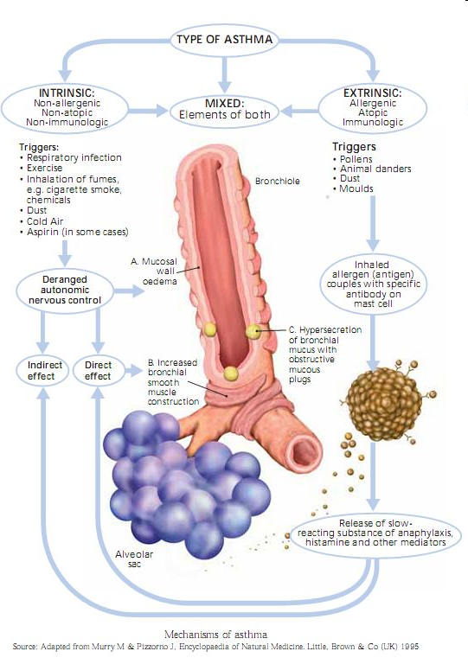
Patient education
Safety of medications and remain compliant
Proper usage
Medical conditions:
viral upper respiratory infections, esophageal reflux
Notes:
elevating the head of the bed, eating smaller meals, not eating within 2–3 hours of bedtime, and avoiding triggering foods, may help,
http://www.ion.ac.uk/images/membership/archive/16.1%20Spring%2003/asthma1.jpg

Slide 24
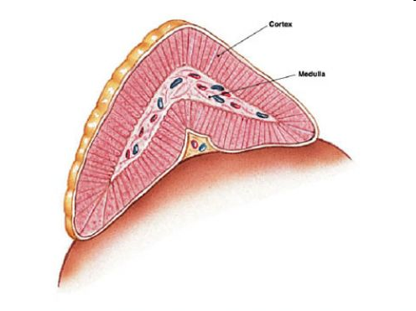
Intrapartum issues
Need to ask if given steroids within the past month
If yes: to prevent adrenal insufficiency, stress-dose corticosteroids are administered (100 mg of hydrocortisone given intravenously every 8 hours)
Notes:
http://z.hubpages.com/u/1431820_f496.jpg

Slide 25
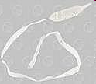
Intrapartum issues
Release of histamines, prostaglandin D2, and leukotrienes from mast cell activation leads to bronchoconstriction
Prostaglandin F_{2α} (carboprost) or ergonovine should be used cautiously or avoided
Prostaglandin E1
Prostaglandin E2
189 pts given dinoprostone without resulting in an asthma exacerbation
Notes:
Hemabate, methergine, 1-cytotec/misoprostol, in animal models caused bronchodilation 2-cervidil/dinoprostone http://i.ehow.com/images/GlobalPhoto/Articles/2372132/cervidil108251_Full.jpg
http://4.bp.blogspot.com/_AEYF6Hx2WbU/RxM5ItKcfMI/AAAAAAAAAAU/_-Zv8odjnqA/s320/misoprostol.jpg

Slide 26
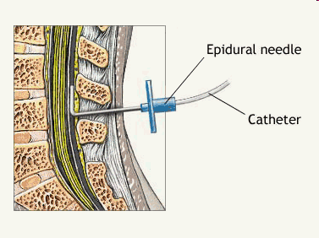
Intrapartum issues
Epidurals gives pain relief which decreases bronchospasm and reduces oxygen consumption and minute ventilation
Meperidine (demerol) should be avoided due to the risk of triggering histamine release
Notes:
http://www.mjhanesthesiology.com/images/second/epidural.gif

Slide 27
A.B. - Hospital course
Induction: cervidil placed, 12 hours later, removed, SVE: 1/25/-3, cervical foley placed
Morphine 5/5 given for pain relief
Foley removed: SVE 3-4/50%/-3
Epidural placed
Pitocin started
NSVD: 3185gm healthy female infant, apgars 9 and 9, no complications

Slide 28
Summary
Be aware of the normal physiological values in the pregnant state
Safer for women to be treated with asthma medications than to have symptoms and exacerbations
Patient education about preventing asthma exacerbations and importance of compliance
L&D: ask about hospitalizations, intubation history and recent oral steroid use and to be cautious with certain medications

Slide 29
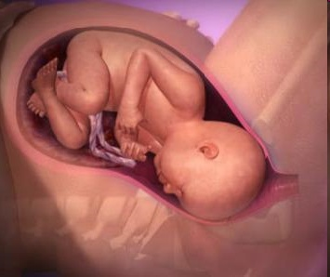
Questions?
Notes:
http://assets.babycenter.com/ims/aug2008/animation_labor.jpg

Slide 30
References
ACOG Practice Bulletin No. 90: Asthma in Pregnancy. Obstetrics & Gynecology. 111(2, Part 1):457-464, February 2008.
Boulet, LP, Rey, E. Asthma in Pregnancy. BMJ March 2007; 334:582-585.
Cydulka, RK et al. Acute Asthma among Pregnant Women Presenting to the Emergency Department. Am J Respir Crit Care Med; Vol 160:887-892.
Kwon, HL, Belanger K, Holford TR, Bracken MB. Effect of Fetal Sex on Airway Lability in Pregnant Women with Asthma. Am Jour of Epid December 2005; Vol. 163, No. 3:217-221.
Martel, MJ et al. Use of inhaled corticosteroids during pregnancy and risk of pregnancy induced hypertension: nested case-control study. BMJ January 2005. http://10.1136/bmj.38313.624352.8F
Murphy VE, Gibson P, Talbot Pl, lifton VL. Severe Asthma exacerbations during pregnancy. Obstet Gynecol 2005; 106:1046-54.
Murphy VE, Clifton VL, Gibson PG. Asthma Exacerbations During Pregnancy: incidence and assocation with adverse pregnancy outcomes. Thorax Journal 2006; 61:169-176.
Towers, CV, Briggs GG, Rojas JA. The Use of Prostaglandin E₂ in Pregnant Patients. Am Jour of Obstetrics and Gynecology 2005;190:1777-80.
Williams Obstetrics: 22nd edition. F. Gary Cunningham, Kenneth L. Leveno, Steven L. Bloom, John C. Hauth, Larry C. Gilstrap III, Katharine D. Wenstrom. Chapters: 5. Maternal Physiology, 46. Pulmonary Disorders. 2005, 2001 by the McGraw-Hill Companies, Inc
http://www.nhlbi.nih.gov/health/prof/lung/asthma/astpreg/astpreg_qr.pdf

