Slide 1
Substance Abuse in Pregnancy
Sophia Y. Feng, MD
Family Medicine
January 12, 2010

Slide 2
Case
30 yo G3P0020 p/w CTX, VB, FM, no LOF, accompanied by an older male (friend of FOB)
No prenatal care
Admits to heroin use 5 weeks ago, EtOH during pregnancy, cigarette use, Utox positive for cocaine
Restraining order against FOB who lives in Florida
10/10 pain, screaming, moving around the room, naked, unable to sit still for anesthesia to put epidural, whispers “Get me something for this pain” to the “friend”, positive track marks on arm
Pediatrics present at delivery
Social work consult requested

Slide 3
Introduction
4% of pregnant women use illicit substances
Half of substance abusing women continue using during pregnancy
An even larger proportion abuse tobacco or alcohol
Many use more than one substance
Pregnant women typically highly motivated to modify behavior to help their unborn child
Many resume substance use postpartum
Notes:
Obstet Gynecol 2003 Feb;101(2):374
J Perinatol 2005 Jun;25(6):368
National survey in US, pregnancy-related abstinence of cigarettes, alcohol, illicit drugs were 40, 74, and 57%

Slide 4
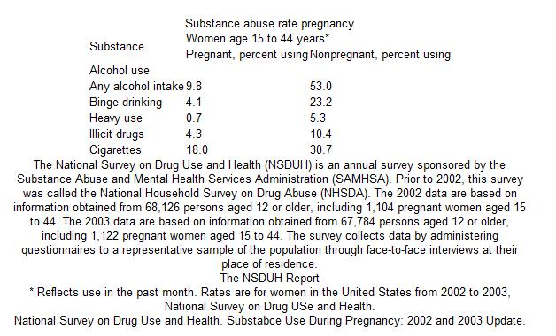

Slide 5
Screening
Substance abusers come from all socioeconomic statuses, ages, and races
Denial – guilt, fear of legal consequences, loss of custody of children
History taking, maternal testing after informed consent, neonatal testing – urine, blood, hair, saliva, sweat, meconium
Be sensitive and respectful in interviewing
Ask about frequency, time of last use, route of administration

Slide 6
Risk Factors
Late prenatal care
Missed prenatal visits
POBHx: miscarriage, IUGR, premature birth, abruption, stillbirth, or precipitous delivery
Child with neurodevelopmental/behavioral problems
Child not living with mother or involved with ACS
History of drug related issues (pancreatitis, abscess, endocarditis, suspicious trauma)
Encounters with law enforcement

Slide 7
Management
Counseling
Social services
Testing for STDs
Frequent prenatal visits, education
Early ultrasound
Antepartum fetal surveillance
Informing pediatrics of possible neonatal withdrawal

Slide 8
Substances
Alcohol
Tobacco
Marijuana
Cocaine
Heroin

Slide 9
Alcohol
No level is safe
Spontaneous abortions, stillbirth due to fetoplacental dysfunction, small for gestational age
ADHD, oppositional defiant disorder, conduct disorder
Binge drinking – Ψ disorders in adult offspring
Future drinking problems in adult offspring
Fetal Alcohol Spectrum Disorder (FASD)
Notes:
(Epidemiology 1997 Sep;8(5):509)
(Am J Epidemiol 2002 Feb 15;155(4):305)
(Pediatrics 2001 Aug;108(2):e34 ) (Pediatrics 2008 Dec;122(6):e1225)
(Dev Med Child Neurol 1997 Sep;39(9):583 )
(Arch Gen Psychiatry 2003 Apr;60(4):377)
(Eur J Clin Nutr 2006 Sep;60(9):1062)

Slide 10
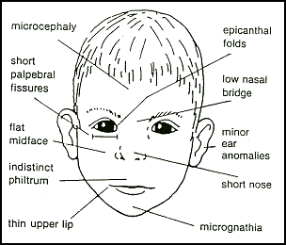
Fetal Alcohol Syndrome
CDC diagnostic criteria, requires all three:
Growth problems
Facial dysmorphia
smooth philtrum,
thin vermillion border
short palpebral fissures
CNS abnormalities
Notes:
http://www.aafp.org/afp/2005/0715/p279.html#afp20050715p279-f3

Slide 11
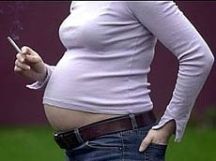
Tobacco
Impaired O2 delivery, nicotine-induced vasospasm, carbon monoxide, other chemicals, chromosomal instability, lung development
Preterm delivery, low birth weight (<2500 g), small for gestational age, PPROM, placenta previa, abruption, IUFD
SIDS, asthma, otitis media
Idiopathic mental retardation, ADHD
Obesity and diabetes in adult offspring
Smoking and use of nicotine substitutes in first 12 weeks, slight risk of congenial malformations
Pharmacotherapy for those who are unlikely to quit
Interestingly, decreased risk of preeclampsia
Notes:
(MMWR 2004 Oct 8;53(39):911)
(Croat Med J 2005 Oct;46(5):832) (BJOG 2008 Oct;115(11):1428)
(Pediatrics 1996 Apr;97(4):547)
(Am J Obstet Gynecol. 2008 Jan;198(1):66.e1-6.)
(Obstet Gynecol. 2006 Jan;107(1):51-7.)
Chest 2005 Apr;127(4):1232
Pediatrics 2009 Dec;124(6):e1054
BMJ 2004 Jun 26;328(7455):1538
http://www.tobacco-facts.net/smoking-facts/pregnancy-smoking-facts
Am J Prev Med. 1999 Apr;16(3):208-15.
BMJ 2002 Jan 5;324(7328):26

Slide 12
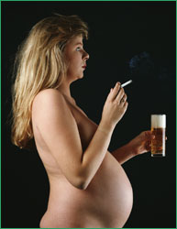
Remember, patients may abuse multiple substances…
Notes:
http://www.nhslothian.scot.nhs.uk/news/annual_reports/publichealth/2005/ar2003/ch4/04.html

Slide 13
Marijuana
Most common illicit substance used in pregnancy
Detectable in urine for weeks
Adverse effects inconclusive: association with sleep disturbance, hyperactivity, inattention, poorer visual problem-solving skills and delinquency
Small head circumference?
Strongly associated with concomitant use of cigarettes and alcohol
Decreased intelligence testing scores
leukemia, rhabdomyosarcoma, astrocytoma
Notes:
Neurotoxicol Teratol 1999 Sep-Oct;21(5):513-25.
Am J Perinatol 1990 Jan;7(1):36-8.
BJOG 2002 Jan;109(1):21-7.
Can Fam Physician 2001 Feb;47:263
J Am Acad Child Adolesc Psychiatry 2008 Mar;47(3):254
http://www.americanpregnancy.org/pregnancyhealth/illegaldrugs.html

Slide 14
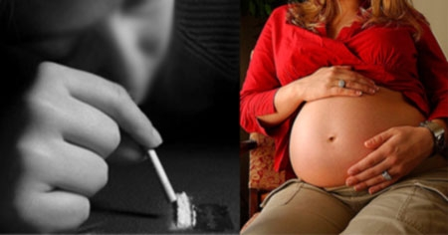
Cocaine
Crosses the placenta and fetal blood-brain barrier
Vasoconstriction, hypertension, may mimic preeclampsia
Spontaneous AB, prematurity, abruptio placentae, fetal death, decreased growth (birth weight, length, head circumference), neonatal tachycardia, cerebral infarction
“crack babies” – jittery/tremors, high-pitched cry, irritability, excessive suck, hyperalertness, autonomic instability
Associated with delayed cognitive, language development?
Beta-blockers contraindicated
Notes:
Pediatrics 2007 Oct;120(4):e1017
JAMA 2002 Apr 17;287(15):1952
JAMA 2001 Mar 28;285(12):1613
Pediatrics 2004 Jun;113(6):1677

Slide 15
Heroin
Preeclampsia, 3rd trimester bleeding, malpresentation, nonreassuring fetal status, meconium, low birth weight, IUFD, prematurity
Neonatal abstinence syndrome (NAS) – increased autonomic reactivity, withdrawal symptoms begin 24 hours after birth, 40 hours with methadone or buprenorphine
Prematurity – reduced risk
Supportive therapy
Psychomotor and neurologic abnormalities, SIDS
Adverse developmental outcomes?
Methadone treatment used in pregnancy, not associated with birth defects
Buprenorphine, good alternative
Notes:
Pediatrics 2004 Jun;113(6):1677
Eur J Pediatr 1998 Sep;157(9):724

Slide 16
What can we do?
Ask – at each visit
Advise - cessation
Assess - willingness
Assist – establish a plan
Arrange – follow up, referrals, support

Slide 17
Thank You

Slide 18
References
“Alcohol intake and pregnancy”
“Smoking and pregnancy”
“Substance use in pregnancy“
“Infants of mothers with substance abuse”
-www.uptodate.com
“Drug use in pregnancy”
“Neonate opidate withdrawal”
- Dynamed

